Slide 1
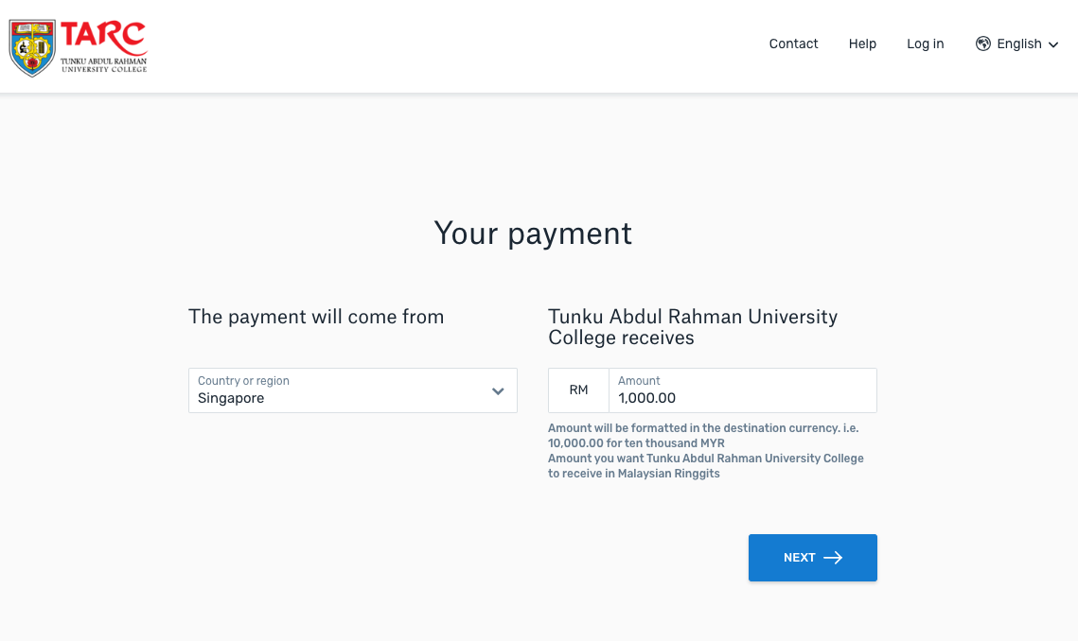
Step 1:
Payers will indicate the country that they are paying from
They will enter the fees they are paying, as per the invoiced amount that is due

Slide 2
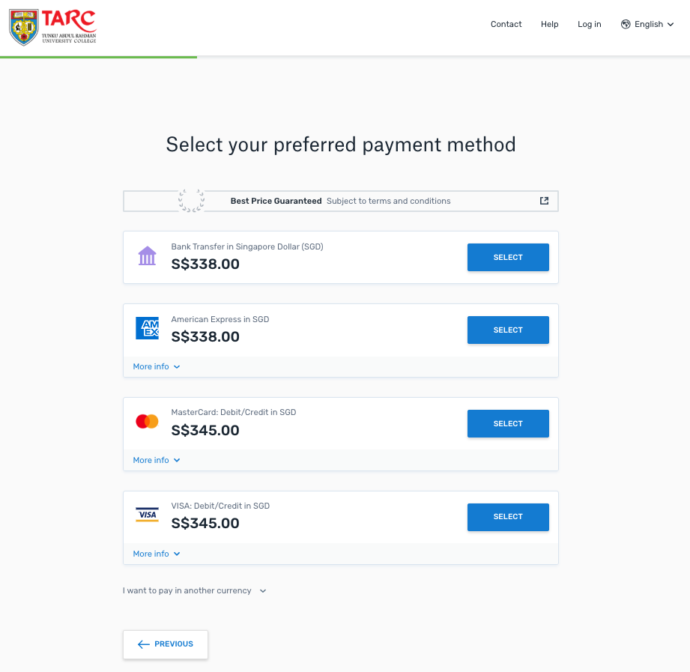
Step 2:
Payers then will select their payment option.
*Options vary depending on country from which payment is being made

Slide 3
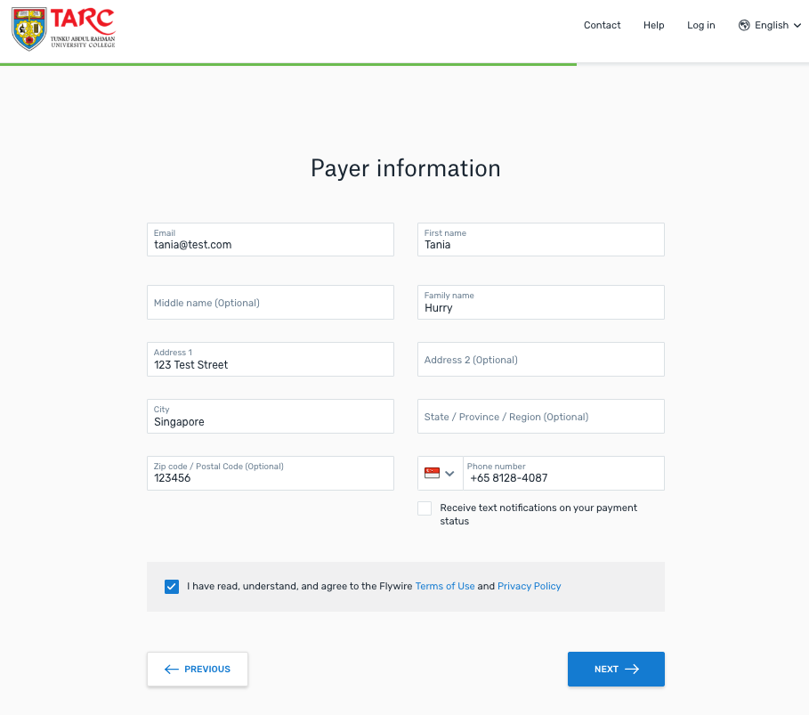
Step 3:
Payers enter in basic information about themselves

Slide 4
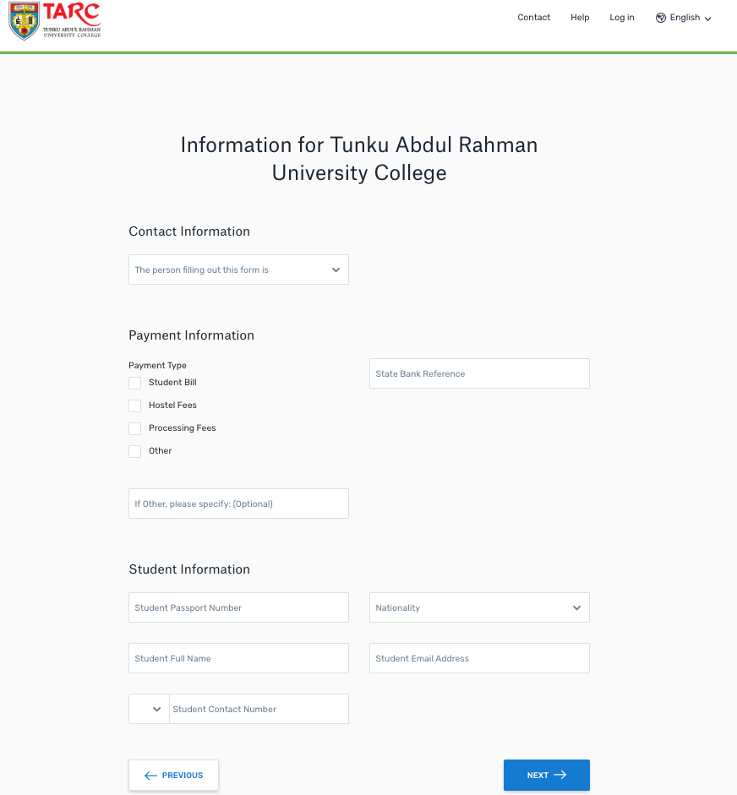
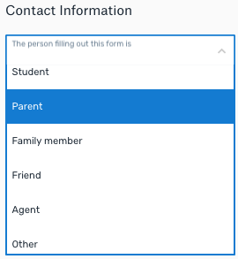
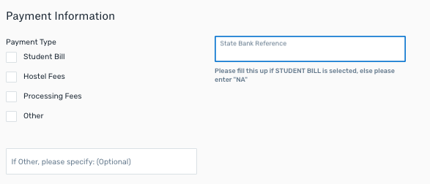
Step 4:
Payers enter in basic information about the student, as requested by TARC

Slide 5
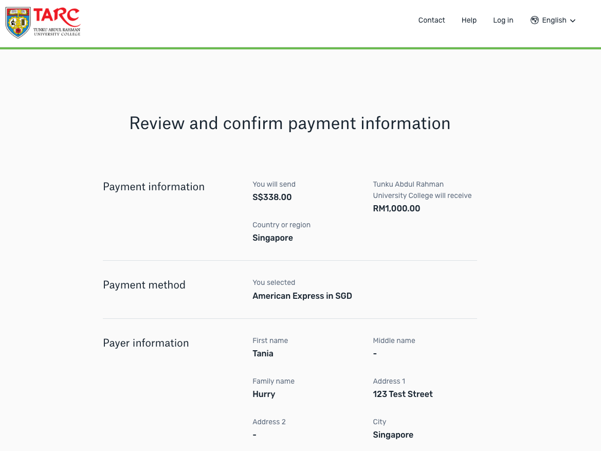
Step 5:
Payers review information they have keyed in, to confirm that it is accurate

Slide 6
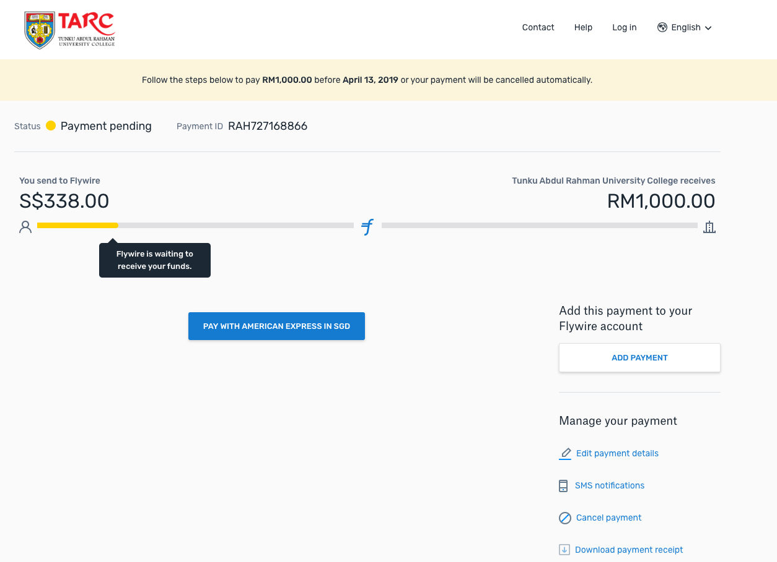
Step 6:
Payer makes their payment on the website if they are using credit card or other online methods
Payer receives bank instruction, if they chose a bank transfer payment

